Slide 1
Win or Lose?
The model to predict S&P 500
Team Members
Sonal Bajaj
Amy Aumpansub

Slide 2
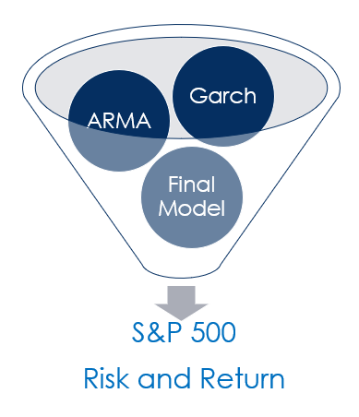
Introduction
Objective
Develop strong predictive models that help investors forecast volatility and reasonable return on their investments regarding the level of risks.
Dataset
Daily Prices of S&P 500 from Jan 2013 - Dec 2017
1260 observations
source: https://finance.yahoo.com/
Using daily adjusted price for time series analysis.
Methodology
Data exploration
ARMA Model with Drift
Backtesting and Forecasting
GARCH Model
Model evaluation & comparison

Slide 3
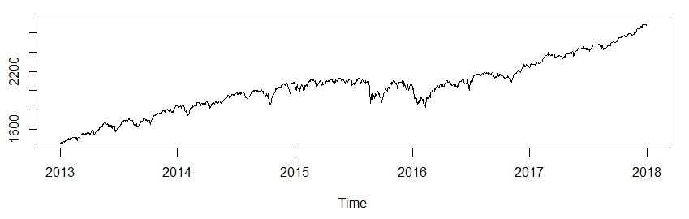
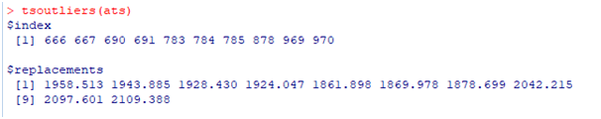
Data Exploration
The series appears to be:
Non Stationary
Has an upward trend
Big Price Drops:
Jan, 2016
Fell 3.9%
Drop in Chinese equities and oil prices at 12-yr lows.
Jun, 2016
Dropped 3.5%
Unexpected Brixit result in the U.K.
Checking Outliers and replacement

Slide 4
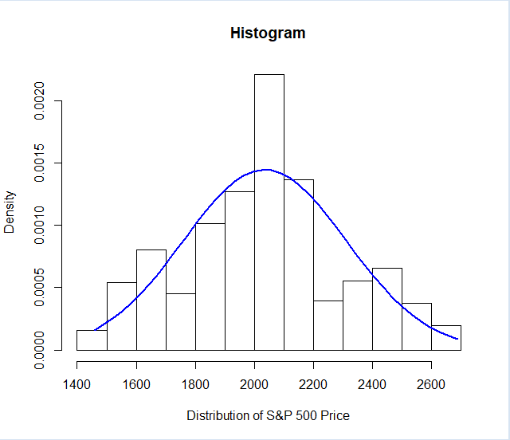
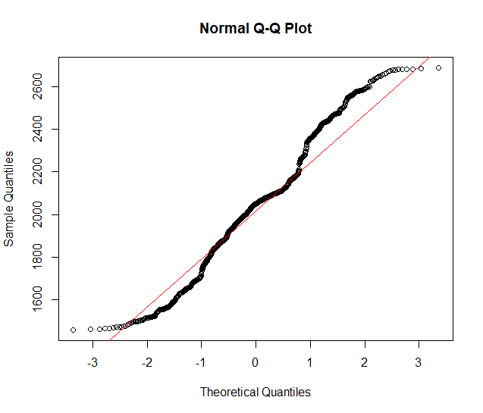
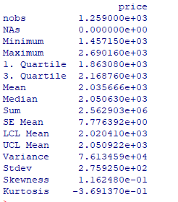
Data Distribution
Histogram displays that the distribution is normal
Normal Probability Plot shows some minor pattern, but statistics indicate that distribution is symmetric.
Symmetric Distribution: Mean ~= Median, skewness =0.0116
Thin tail: Kurtosis = - 0.369

Slide 5
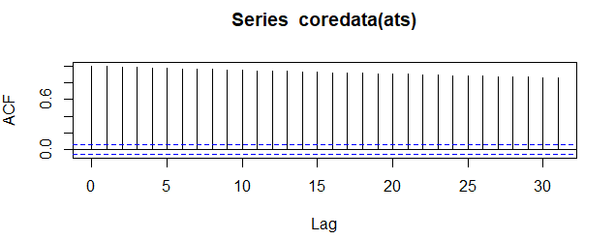
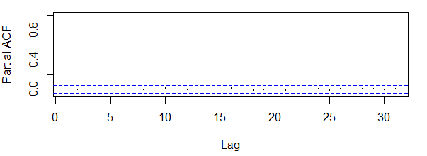
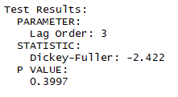
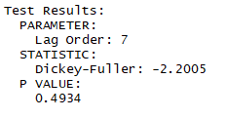
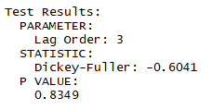
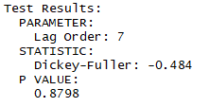
Non-stationary Process
Slow Decay
Spike at lag 1
Dickey-Fuller Unit Root Test
With time trend
With no time trend
p > 0.05 → Accept H₀ (Single unit root)
The process is not stationary.

Slide 6
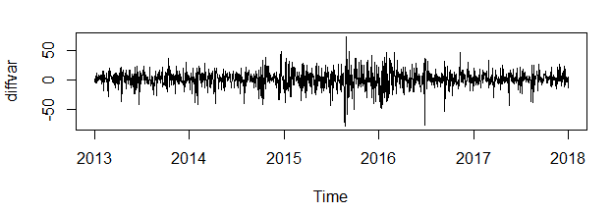
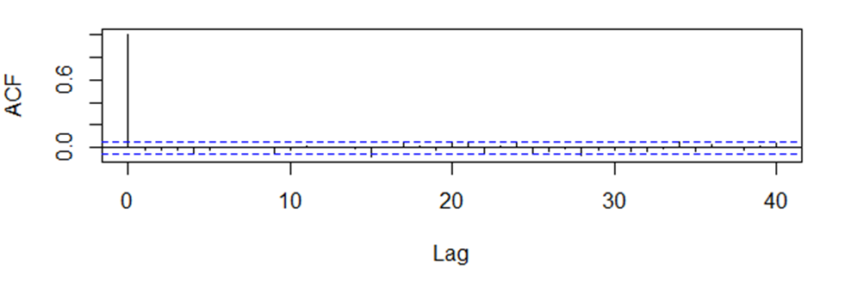
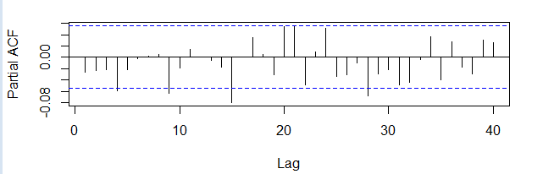
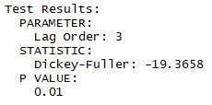
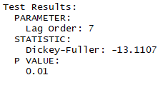
After First Differencing
ACF shows no serial correlation
Stationary series with zero mean
PACF shows some seasonal trends.
Dickey-Fuller Unit Root Test
p < 0.05 → Reject H₀
The process is stationary.

Slide 7

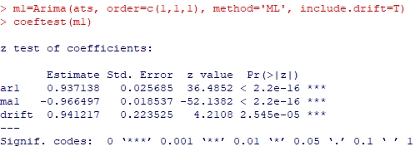
AutoArima
BIC
AIC
Seasonal Model
Model M1: Arima (1,1,1) with drift
Model Equation:
(1- 0.94B)(1-B)X_{t} = 0.941 + (1- 0.967B)a_{t}
All parameters are significant
p-value < 0.05

Slide 8
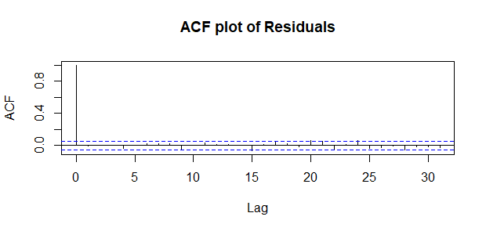
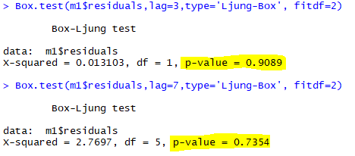
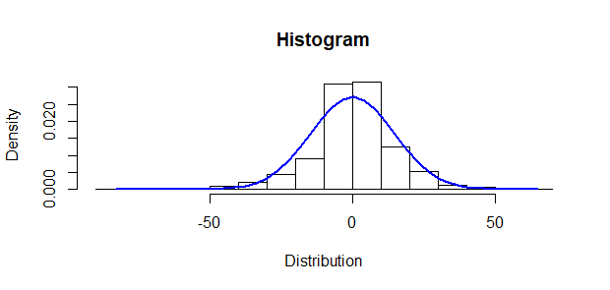
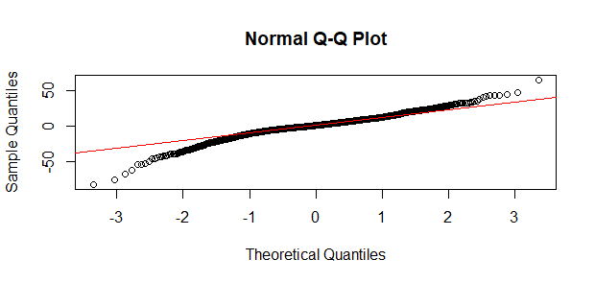
Residual Analysis
No Serial Autocorrelation! Residuals are white noise.
Residuals are normally distributed.

Slide 9
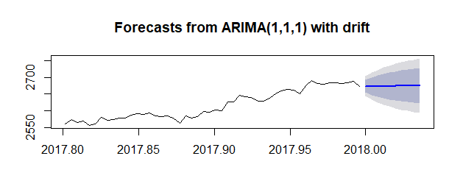
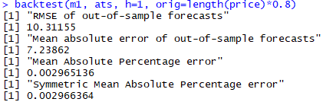
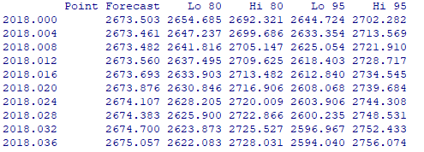
Backtesting and Forecasting
One step ahead forecast are 0.29% off from the observed value.
Forecast shows a slight upward trend.

Slide 10
Is the ARMA (1,1,1) model good enough?
An ARMA(p,q) model specifies the conditional mean of the process
What about volatility?
Does not capture a significant GARCH effect that implies a non constant volatility
Distribution of price is symmetric with thin tail
A GARCH model imposes a structure of the conditional variance of the process.
A further analysis is required.
An ARMA(p,q)-GARCH(s,r) would be a better model.

Slide 11
GARCH MODEL

Slide 12
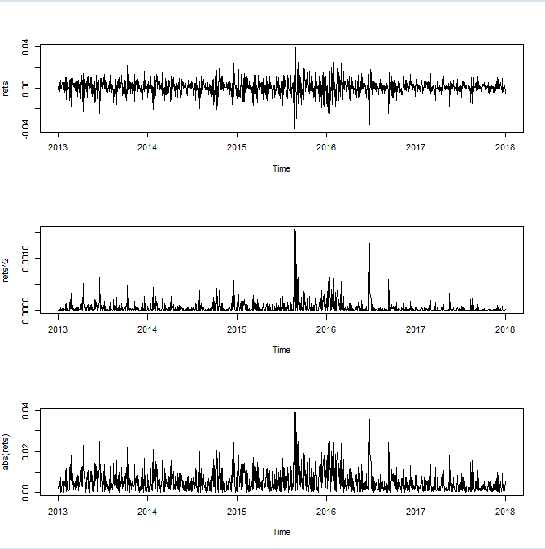
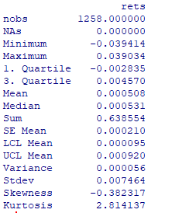
Data Exploration (Simple Return)
Plots of returns, returns² , abs(returns)
Basic Statistics
Volatility clusters
Non constant Volatility
Zero Mean.
Close to zero Skewness
Thin tails as Kurtosis<3

Slide 13
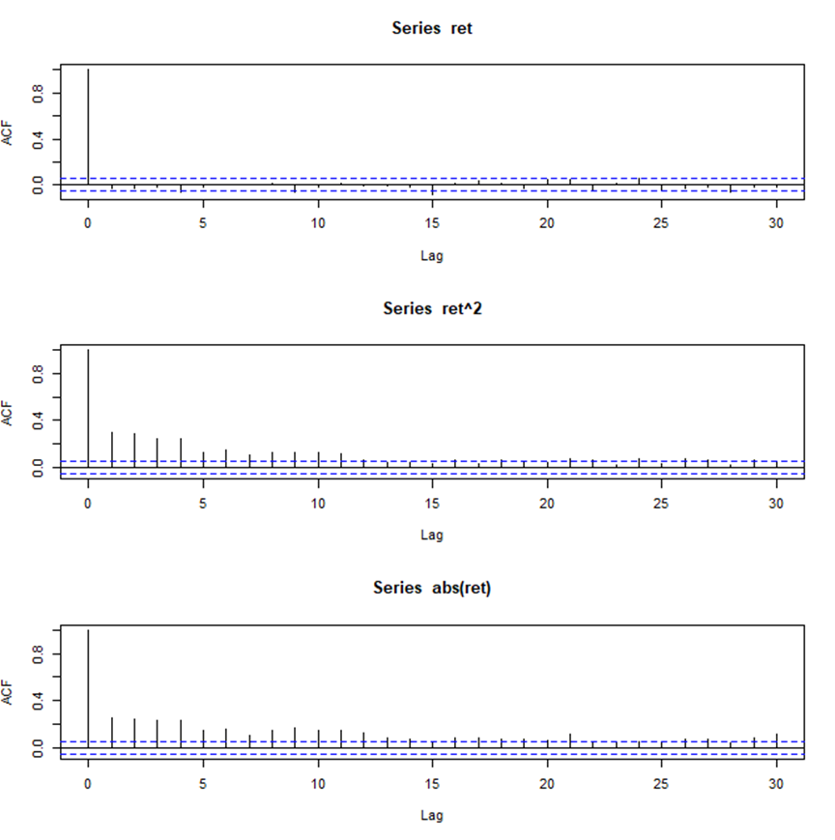
ACF Plots of returns, returns² , abs(returns)
S&P 500 returns
Show serial autocorrelation
Show a significant ARCH/GARCH effect, implying a non constant volatility
Show non linear dependence

Slide 14
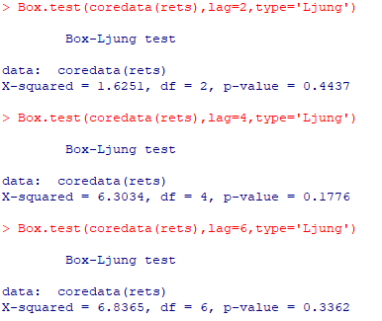
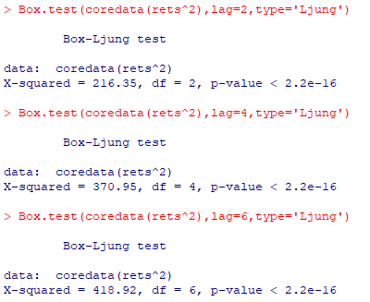
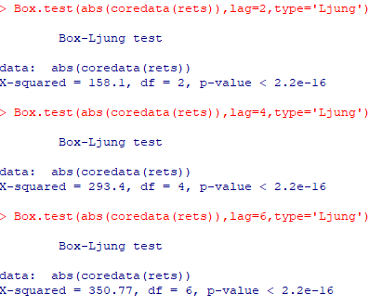
McLeod -Li Test for ARCH/GARCH effect
Test on returns
Test on squared returns
Test on absolute returns
Reject H₀: p < 0.05
Have serial correlation

Slide 15
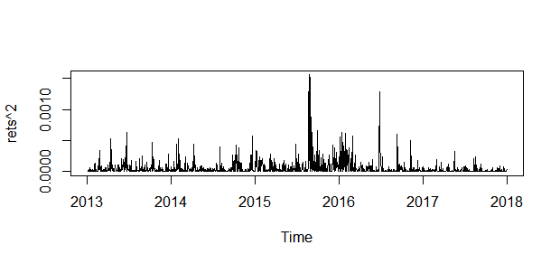
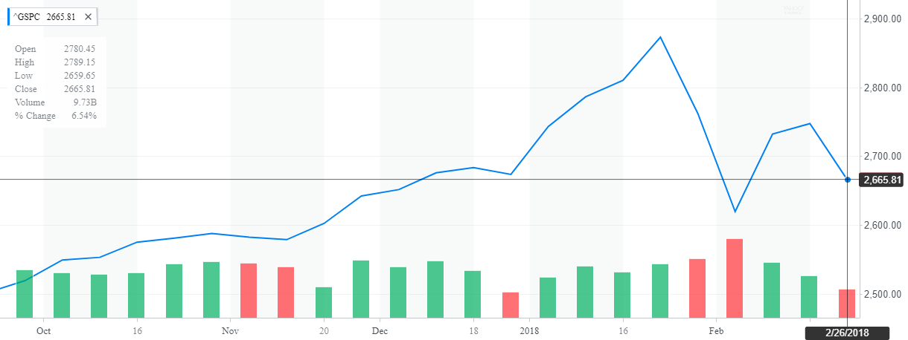
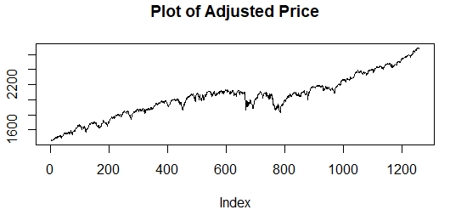
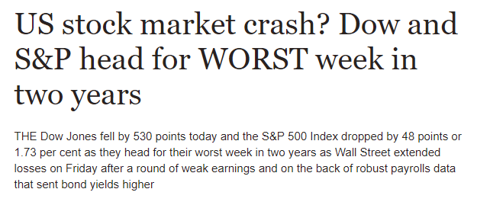
Leverage/Asymmetric Behaviour
Highest turbulence in 5 years when the prices went down!
Recent market crash last month
A negative shock has a stronger impact on the volatility compared to a positive shock of the same size
https://www.express.co.uk/finance/city/913867/dow-jones-S-P-500-Google-parent-Alphabet-Apple-Microsoft-Nasdaq-CBOE-Volatility-Index

Slide 16
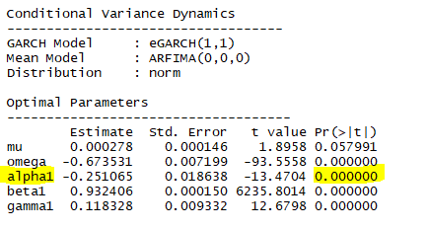
Model 1 ARMA(0,0) - EGARCH(1,1) with Norm-distribution
alpha1< 0
Leverage effect is significant
Volatility reacts more heavily to negative shocks.
gamma1 is significant, indicates volatility has an asymmetric behaviour,
Model Expression:
r_{t} = 0.000278 + a_{t}, a_{t} = σ_{t} e_{t}
ln( σ_{t}²) = -0.674 + (– 0.251 e_{t-1} + 0.118 (|e_{t-1}| - E(|e_{t-1} | )) + 0.9324 ln( σ²_{t-1})

Slide 17
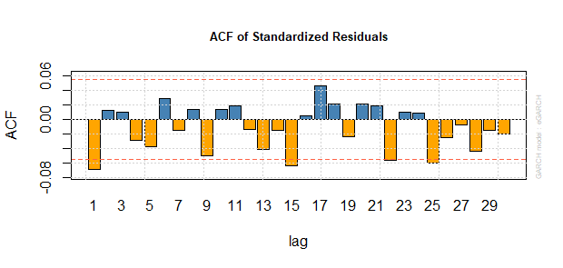
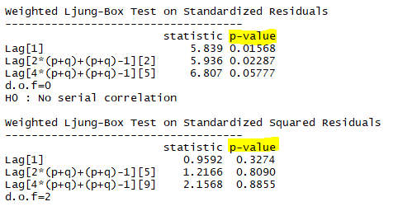
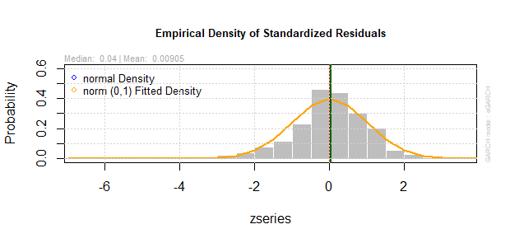
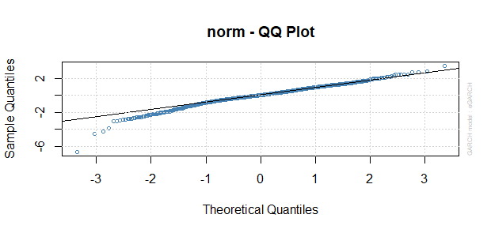
Residual Analysis
Some p-values are < 0.05.
Problem in residuals.
Residuals are not white noise
QQ plot shows some deviation from normality

Slide 18
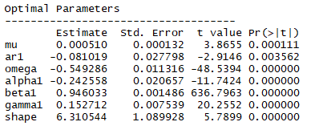
MODEL 2: ARMA(1,0)-EGARCH(1,1) with t-distribution
All Parameters are significant
Shape parameter is significant, showing t-distribution is a good choice
Model Expression:
r_{t} = 0.00051 – 0.08 a_{t-1} + a_{t}
a_{t} = σ_{t}e_{t} ln( σ_{t}²) = -0.549 – 0.243 e_{t-1} + 0.153 (|e_{t-1} |- E(e_{t-1} )) + 0.946 σ_{t-1}²
Where the error term e_{t} has t-distribution with 6 degrees of freedom.
The leverage parameter is alpha1/gamma1 = -0.2426/0.1527 = -1.589

Slide 19
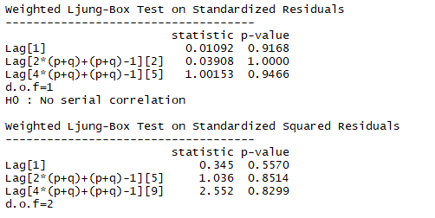
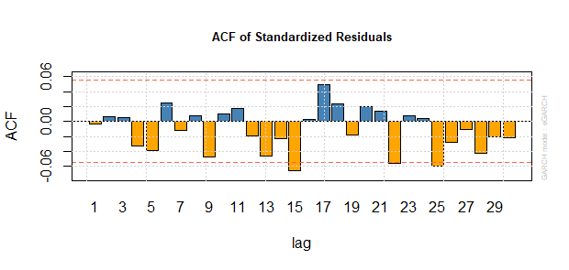
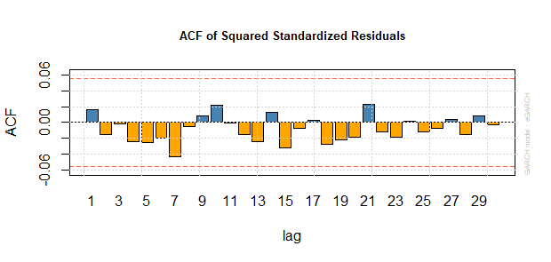
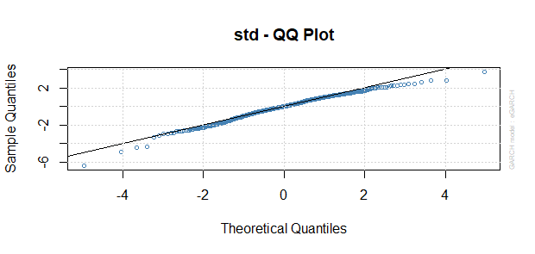
Residual Analysis
p-value > 0.05
No serial correlation
Residuals are white noise
QQ plot
indicates
normality

Slide 20
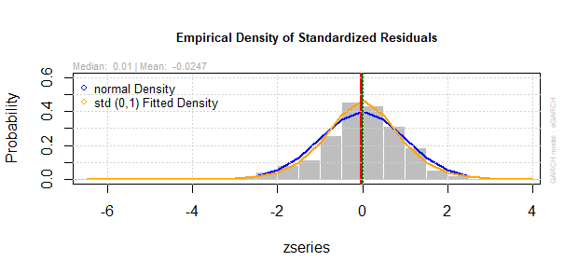
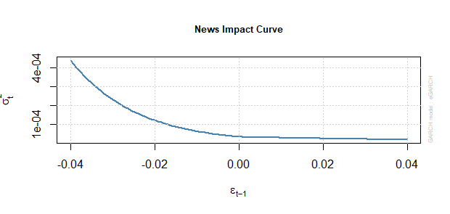
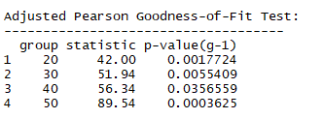
Model 2: ARMA(1,0)-eGARCH(1,1) with T-distribution
Shows t-distribution is a better fit

Slide 21
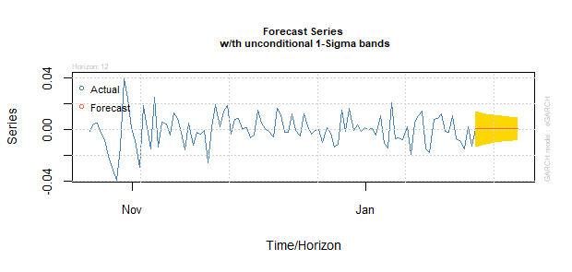
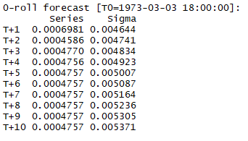


Forecasting
Ten step ahead forecast

Slide 22



Model Comparison
Comparing EGARCH Models
Model 1
Model 2
AIC and BIC values are lower in Model 2
Model 1
Model 2

Slide 23
Conclusion
Limitations and Future Studies
The final model is ARMA(1,0)-eGARCH(1,1) with T-distribution
Has the lowest AIC,BIC, and MAE
Mean Absolute Error of 0.00284928 indicates how big of an error we can expect from the forecast on average.
Model is predicting an upward trend in the future which is similar to the actual trend.
One-Step ahead forecast (Jan 2nd, 2018):
Predicted Daily volatility is 0.4644%
Actual Daily return is 0.8303%
The stock price relies heavily on the future expectation
Comparing to the fundamental analysis, the technical analysis that we used does not capture the macroeconomic and microeconomic factors that drive the market movements such as the overall economy and industry condition, future financial performance, and company management
Develop an advanced model to study the effect of the economy growth on the S&P 500 prices.

Slide 24
Thank You
Team Members
Sonal Bajaj
Amy Aumpansub

Slide 25

https://www.pinterest.com/pin/383157880779275327/

